Slide 1



Slide 2

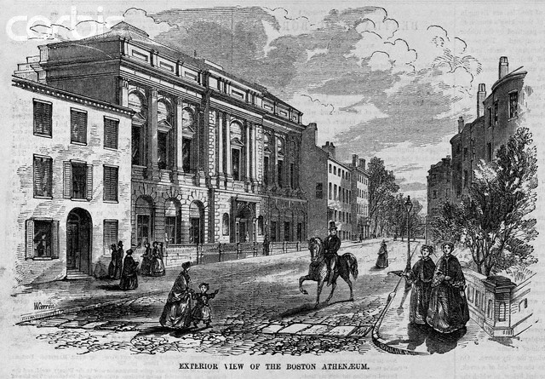
The Boston Athenaeum

Slide 3

• Located in Boston Massachusetts.
• One of Boston’s leading cultural institutions.
• The library was considered one of the finest in the country in the 1800’s
• One of the oldest independent libraries in the United States.
• Founded in 1807 by the Anthology Club of Boston, Massachusetts.
• Built in 1847.
• Has a neoclassical architectural style.
• The first floor held the sculpture gallery; the second, the library, and the third, the paintings gallery.
• The architect was Edward Clarke Cabot.
• Declared a National Historic Landmark in 1966.
• 5 stories tall.
• Has a basement
• Made from stone.
• Flat roofed so it’s possible to go onto it.
• First opened its doors in 1807.
• More than 600,000 in title in books.

Slide 4

Founded 1716 as Fort Rosalie
renamed by 1730
Total area- 13.9 square miles.
One of Mississippi's oldest European-American cities,
Founded by French colonists in 1716
Located along the Mississippi River
The original site of Natchez was developed as a major village with ceremonial earthwork mounds, built by people of the prehistoric Plaquemine culture, part of the Mississippian culture.
Archeological evidence shows they began construction of the three mounds by 1200 CE.
Permanent French settlements and plantations were subsequently established in 1700’s
On October 27, 1795, all Spanish claims to Natchez were formally surrendered to the United States.

Slide 5

Children lived with their parents in the slave cabin, unless their parents were sold to another plantation or vice versa
Small famers usually had only a bed or mattress to sleep on in the attic or a back room.
Larger slave owners housed slaves in one-roomed cabins with dirt floors and few furnishings (table, stools, a cooking pot, and dishes, and a bed or corn-shuck mattresses)
The cabins were usually twelve feet by twelve feet, with a couple closets smaller and closer than the state rooms of a ship.
They almost all had a rude bedstead, with gray moss of the forests for mattress, and filthy blankets for covering.
Made of wood
Chimneys were brick and outside.
The cabin contains a loft that was originally lighted by two windows with hinged shutters.
Very weakly made
Weak roofs.
Steep roofs for snow and rain to fall off easily.
Usually consists of one door.

Slide 6

A cotton mill is a factory that houses spinning and weaving machinery.
Built between 1775 and 1930.
Mills spun cotton which was an important product during the Industrial Revolution.
The architectural development of the cotton mill was linked to the development of the machinery which it contained, the power unit that drove it, and the financial instruments used for its construction.
The 1819 Cotton Mills and Factories Act stated that no children under 9 were to be employed and that children aged 9–16 years were limited to 12 hours work per day.

Slide 7

Athenaeum- A building or institution in which books, periodicals, and newspapers are provided for use; a literary club-room, reading-room, library.
Furnishings- The movable articles in a room or an establishment that make it fit for living or working.
Neoclassical architectural- buildings that are inspired by the classical architecture of ancient Greece and Rome.
Weave- To make (cloth) by interlacing the threads of the weft and the warp on a loom.
Institution- One long associated with a specified place, position, or function.

Slide 8

Edward Clarke Cabot. - was a Boston architect, designed the Gibson House for widow Catherine Hammond Gibson and her son Charles Hammond Gibson, as well as the new building for the Boston Athenaeum between 1847 and 1849.
Samuel Crompton - English inventor and pioneer of the spinning industry. Also invented the spinning mule.

Slide 9


Slide 10
1. Where is the Boston Athenaeum located?
a. New york b Florida C Massachusetts d Spain answer- C
2. About how many titles of books did the Boston Athenaeum contain?
A 1 million b 5 million c 100,000 d 600,000 answer- d
3. How many stories tall is the Boston Athenaeum?
A 2 b 8 c 9 d 5 answer-d
4.What State is the city Natchez located in?
A New York b Mississippi c. Idaho d North Carolina answer c
5. What year was Natchez, Mississippi founded?
A 1800 b 2001 c 1755 d 1716 answer- d

Slide 11
6. About how many square miles is Natchez, Mississippi?
a. 14 b 5 c. 88 d 99 answer- a
7. What did slaves stay in at plantations?
A manor house b the mansion c the slave cabin d the ground answer- c
8. What is the slave cabins made out of?
A stone b brick c metal d wood answer-d
9 what river is Natchez Mississippi located on?
A Rio Grande b the Mississippi c yellow stone river d snake river
Answer-b
10. Who surrendered their claims of Natchez Mississippi to the US?
A Spain b England C Italy d Japan answer- a

Slide 12

Out of many, Author- John Faragher
www.wikipedia.org
http://www.thefreedictionary.com/
http://www.worldatlas.com

Slide 13
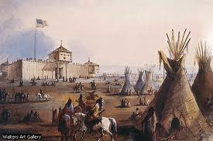
CHAPTERS 13-15
Fort Laramie

Slide 14
THE PREINDUSTRIAL CITY- PAGE 354
They were the “walking cities” where people got around on foot.
Philadelphia- which had been laid out by William Penn in 1682
It was an orderly grid of streets ordered by neat row houses in a dense small scale housing pattern that fostered neighborliness
In these cities, rich and poor lived side by side
Merchants lived next door to their businesses
In the busy streets and public places they daily rubbed elbows with their employees and with artisans and laborers
The wealthy enjoyed unquestioned authority.
Merchants sat on the city council which had broad powers to regulate the public markets, to set process for basic foodstuffs
Wealthy men were active in neighborhood volunteer fire departments and kept the neighborhood order.
When larger disturbances such as bread riots broke out, the mayor and other city officials were expected to appear and disperse the mob by force of their own authority

Slide 15
GERMAN BEER HALL- PAGE 283
Offered music and contact with nature as well as beer from the owner’s breweries.
Much of the dismay of American tolerance reformers, German immigrants viewed beer halls and gardens as gathering places for the entire family.
Appears to be a formal setting. Everyone is dressed up
Has a very high ceiling with a sunroof to show more nature effects of the place.
The roof is arched for architectural purposes.
High lamp posts with 3 lights at the top
Many wooden tables to make it a more social meeting place.
A stage with a band playing on it for musical entertainment
A garden in the back for natural imagery
Pets were allowed there with their owners
Wooden flooring

Slide 16
FORT LARAMIE- PAGE 398
was a significant multiracial 19th century trading post
about 833 acres big
Established March 4, 1931
Named at first in about 1833 as Fort William after founder William Sublette
Located in Goshen County, Wyoming.
was a primary stopping point on the Oregon Trail.
Made of wood.
Very large central plaza area.
There are 2 stories.
Lookout posts on the second floor.

Slide 17
WALL STREET 1857- PAGE 437
street in Lower Manhattan, New York City.
It runs east from Broadway to South Street
first permanent home of the New York Stock Exchange
It was constructed to protect against English colonial encroachment.
In the 1640s basic picket and plank fences denoted plots and residences in the colony
originally called "de Waal Straat"
the panic of 1857 was the first economic depression in which he telegraph played a part by carrying bad financial news in the west to new york.
caused from the declining international economy and overexpansion of the domestic economy
result of the Panic of 1857 was the southern economy suffered little whereas the northern economy made a slow recovery. The area affected the most by the Panic was the Great Lakes region.
Wall Street's architecture is generally rooted in the Gilded Age
Landmark buildings- Federal Hall, 14 Wall Street, 40 Wall Street, the New York Stock Exchange at the corner of Broad Street and the US headquarters of Deutsche Bank at 60 Wall Street.
The Deutsche Bank building is the last remaining major investment bank to still have its headquarters on Wall Street.

Slide 18
OLD SENATE CHAMBER- PAGE 424
The compromise of 1850 was held here.
designed in Neoclassical style
elaborately decorated.
Has two stories
50 feet wide and 75 feet long
Has a half-domed ceiling
inspired by the Erechtheum of the Acropolis of Athens.
completed in 1810
Very high, decorative ceiling painted white
Above the eagle ornament on a third-story gallery resides an original portrait of George Washington by Rembrandt Peale.
Many white decorated columns for support of the massive ceiling.
Red flooring with red drapes.

Slide 19
2 PEOPLE THAT PERTAIN TO ARCHITECTURE-
William Sublette- Born in Stamford, Kentucky on September 21, 1799. Died on July 23, 1845. Sublette was a fur trapper, pioneer and mountain man, who with his brothers after 1823 became an agent of the Rocky Mountain Fur Company (and later one of its owners) exploiting the riches of the Oregon Country, which helped settle the best routes later improved into the Oregon Trail.
George Washington- elected unanimously as the first president in 1789, and again in the 1792 election; he remains the only president to have received 100 percent of the electoral votes.

Slide 20
5 TERMS
Foster- To promote the growth and development of
Oregon Trail- early pioneering route across the central US
Gilded Age- refers to major growth in population in the United States and extravagant displays of wealth and excess of America's upper-class during the post-Civil War and post-Reconstruction era, from 1877 to 1900.
Picket fence- a variety of fence that has been used mostly for domestic boundaries.
Ornament- Decorative arts

Slide 21

10 MULTIPLE CHOICE QUESTIONS-

Slide 22
1.why were the preindustrial Cites called “walking cities”
a. the city walked around at night b people got around on foot there
c the mammals there walked and talked d. a and c answer- b
2. In preindustrial Cities…
A the people were 9 feet tall b the people were wiped out by a disease
C the rich and poor lived side by side d there weren’t any rich answer- c
3. the wealthy in preindustrial cities…
A weren’t really rich b had authority that they enjoyed c were all women
D didn’t have pets answer- b
4 Wealthy men were ________ in neighborhood volunteer fire departments and kept the neighborhood order.
A active b inactive c unproductive d not participants answer- a
5. German beer halls offered ______ and contact with nature as well as beer from the owner’s breweries.
A music as entertainment b free beer! C women d appetizers answer- a

Slide 23
6 German beer halls were a very _____ place.
a. Dark b ugly c social d. a and b answer- c
7 what was a significant multiracial 19th century trading post?
A McDonalds b wall street c old senate chamber d Fort Laramie answer-d
8. wall street runs from Broadway to _____ Street
A north b south c east d west answer- b
9 Old senate chamber was decorated with a ________ architectural style.
A neoclassical b German c USAn d Greek answer- a
10. a portrait of _______ ________ is hung above the American eagle ornament in the Old senate Chamber.
A Thomas Edison b George Washington c George Bush. D. John jay. answer b

Slide 24
REFERENCE-
Out of Many, Author- John Faragher
www.wikipedia.org
http://thefreedictionary.com/
http://worldatlas.com

Slide 25

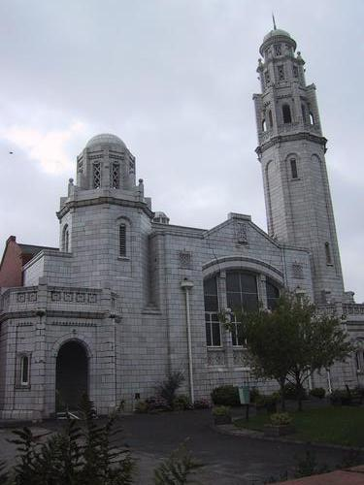
Brick congregational church

Slide 26

Located in Galesburg Illinois
Romanesque style
The Church is constructed of brown, raindrop sandstone
There are huge stone blocks that are made of natural bed stone
The building is 135 feet from east to west, and 133 feet, five inches from north to south.
The ceiling and roof are made of wood
Eighty tons of iron and steel were used in the construction of the Church
The seating capacity was 950 in the Sanctuary
Many stained glass windows in the church.
The round, or Rose, window above the east entrance is 22 feet in diameter with a Greek cross in the center
133 feet high
Has a bell at the top
The bell was replaced with a new one

Slide 27

museum and art school in Philadelphia, Pennsylvania.
It was founded in 1805
the oldest art museum and school in the US.
The Academy's museum is internationally known for its collections of 19th and 20th century American paintings, sculptures, and works on paper.
Its archives house important materials for the study of American art history, museums, and art training.
was founded in 1805 by painter and scientist Charles Willson Peale and sculptor William Rush
architects: Frank Furness and George Hewitt
Architectural style: Second Empire, Renaissance, Gothic
Built from 1871 to 1876
It opened as a museum in 1807 and held its first exhibition in 1811 where more than 500 paintings and statuary were on display.
The Academy was reconstructed after the fire of 1845.
70 feet tall
Was a very tall building in 1876
Gothic window above the doors in the front.
Roof made of iron in 1876. (has been removed)
Made from rusticated brownstone

Slide 28

Currently named Isaac M. Wise Temple
The temple building was designed by prominent Cincinnati architect James Keys Wilson.
Located Cincinnati, Ohio
Built by members of the Lodge Street Synagogue
The temple and was dedicated on Friday, August 24, 1866 and is among the oldest synagogue buildings still standing in the United States.
Built 1865
Architectural style is Germanic
originally budgeted at a cost of US$35,000 for the land, and $55,000 for the building, the total cost of the enterprise exceeded $300,000, largely due to post Civil War inflation.
There is a rose window in a pointed arch, and minarets serving as towers on the top of the building.
Light brown colored with outline of lighter brown and white

Slide 29

scientist Charles Willson Peale- an American painter, soldier and naturalist. Peale had a great interest in natural history, and organized the first U.S. scientific expedition in 1801. These two major interests combined in his founding of what became the Philadelphia Museum, and was later renamed the Peale Museum.
Frank Furness- an acclaimed American architect of the Victorian era. He designed more than 600 buildings, most in the Philadelphia area, and is remembered for his eclectic, muscular, often idiosyncratically-scaled buildings.

Slide 30

Sanctuary- A sanctuary is the consecrated area of a church or temple around its tabernacle or altar.
Gothic architecture- a style of architecture that flourished during the high and late medieval period. It evolved from Romanesque architecture and was succeeded by Renaissance architecture.
Synagogue- a Jewish house of prayer.
Inflation- inflation is a rise in the general level of prices of goods and services in an economy over a period of time
Renaissance architecture- The architecture of the period between the early 15th and early 17th centuries in different regions of Europe, in which there was a conscious revival and development of certain elements of ancient Greek and Roman thought and material culture.

Slide 31


Slide 32
1. Where was the Brick congregational church Located?
a. Galesburg Illinois b. Boston Massachusetts c. long island, New York d. Charleston, North Carolina. Answer- a
2. What was the seating capacity in the sanctuary in the Brick Congregational church?
a. 2,000 b 1,500 c 950 d 550 answer- c
3. What is at the top of the Brick Congregational Church?
a. sculpture b clock c. flag d. bell answer- d
4. What is the oldest art museum and school in the United States?
a. Pennsylvania Academy of Arts b. Massachusetts college of art and design c. Julian Ashton Art school d. Ringling college of art and design
answer- a
5 What is one of the architectural styles of the Pennsylvania Academy of Arts?
a. Egyptian b. Renaissance c gothic d. American!
Answer- c

Slide 33
6. when was the Pennsylvania Academy reconstructed?
A after 1875 b after 1888 c after 1805 d. after 1845
Answer- d
7 what is the Plum Street Temple currently named?
a. Plum Street Temple b Angor Wat temple c Isaac M. Wise Temple d. Doric Greek Temple
answer- c
8. What caused inflation and making the cost of the Plum Street Temple rise?
A civil war b world war 1 c Vietnam d world war 2
Answer- a
9. who built the Plum Street Temple?
a. Every Ohio Residence b members of the Lodge Street Synagogue c. The Senate d. the army
answer- b
10. Why was the Pennsylvania Academy of Arts considered a very large building in 1786?
a. the other buildings were destroyed in a fire. B there weren’t large buildings in 1786 to compare to it. C both a and b d none of the above.
Answer-b

Slide 34
Reference- http://en.wikipedia.org/wiki/Temple
http://www.encyclo.co.uk/define/Renaissance%20architecture
http://www.daap.uc.edu/library/archcinci/4wisetemple.html
http://www.greatbuildings.com/types/usa/usa_1800-1899.html

